Slide 1
Datafest 2025
Sam Castillo

Slide 2
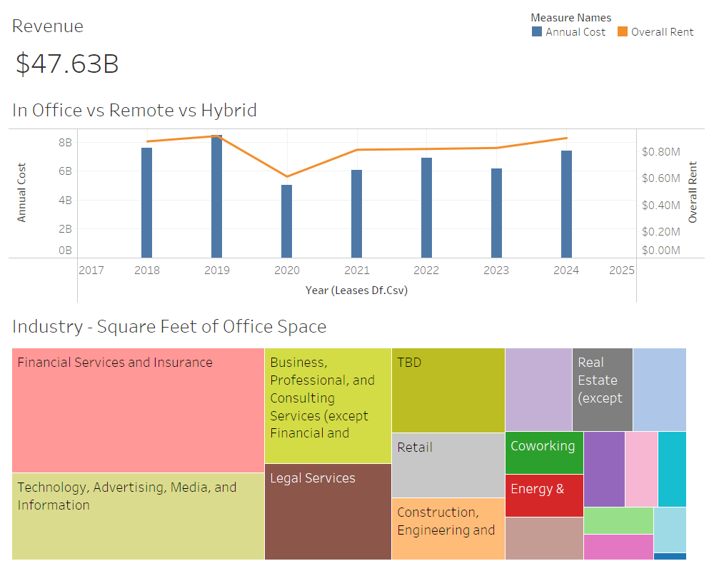

Slide 3
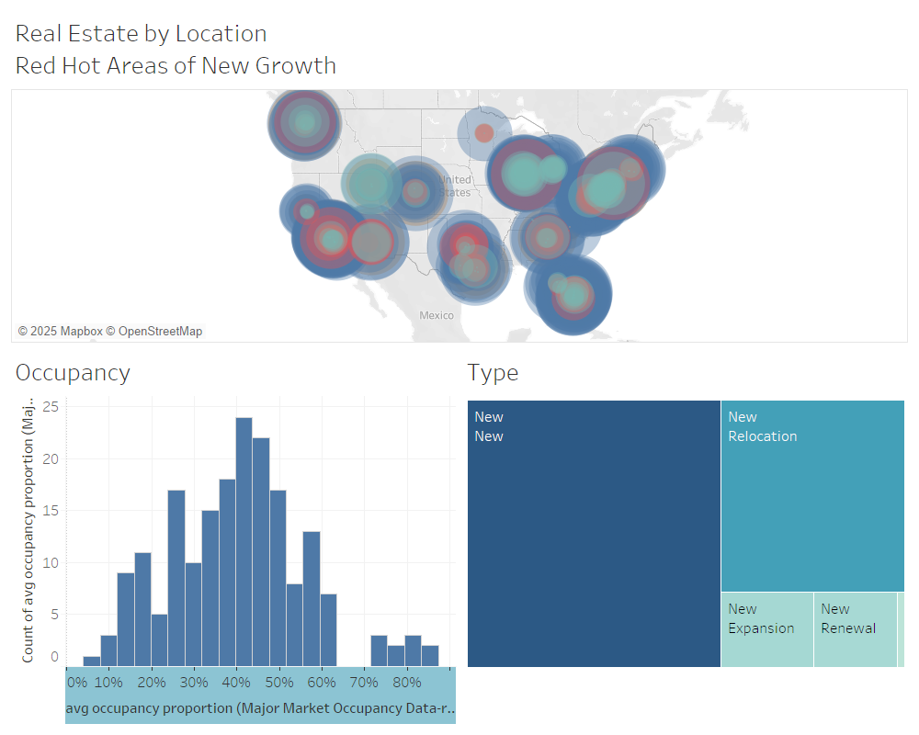

Slide 4

Action Items
Companies that are opening new offices may benefit from high-growth/high-profit margin areas
Impact of COVID resulted in 29% decrease in revenue from commercial real estate
InsurTech and FinTech (Insurance, Financial Services, Legal) have most office space available.

